Slide 1
Practical Data Compression
Lewis Wilson (1413099/ma14ljw)

Slide 2
What is Data Compression?
Data is stored uncompressed on a hard drive/other medium;
Uncompressed data consists of multiple ‘bits’ (computer storage units);
Compression - represent/store data using fewer bits;
Two types of compression:
Lossless – Data is stored in it’s entirety
Lossy – Unnecessary data is removed
Applied to MP3, JPEG, ZIP, RAR, FLAC etc...
Dissertation focus – Lossless Compression

Slide 3
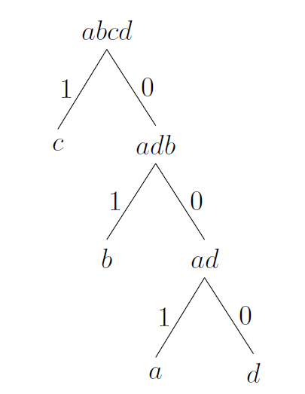
Huffman Coding
Encoding Example
Lossless, symbol-based method;
Each character original message represented with binary value (codes);
High occurrence rate characters have lower binary code;
Codes generated using binary Huffman Tree;
When reading ‘per-bit’ each code is unique
Example data: aabbbccccd
Associated Huffman Tree:
Code representations:
‘a’ = 001
‘b’ = 01
‘c’ = 1
‘d’ = 000
Encoded data: 0010010101011111000

Slide 4
Lempel-Ziv-77 (LZ77)
… | Search Buffer | Look-Ahead Window | …
Encoding Example
Lossless, dictionary-based method;
Search buffer and look-ahead window;
Characters read in order, matches are looked for in search buffer;
If character match is found, the next look-ahead value is appended, process repeats;
Search buffer/look-ahead window can vary in size
Example data:
Read first look-ahead character ‘b’
Search buffer match (offset 2)
Append next look-ahead character ‘bc’
Offset 2 not suitable
Search buffer offset 6 suitable
Append next look-ahead character ‘bcc’
Repeat…
...abc | cbccbba | bccbcc | aab…

Slide 5
Lempel-Ziv-4 (LZ4)
Lossless, dictionary-based method;
Uses tokens, literals and offset values:
Literals: Symbol/Character Values;
Token: 1-byte field;
Upper 4-bits = number of literals
Lower 4-bits = length of data match
Offset: Number of characters to traverse from end of current string
Standard LZ4 Block Format

Slide 6
LZ4 Decoding Example
Token | Literals | Offset | Token | Literals | Offset | Token | Offset
40 | abcc | 03 00 | 13 | b | 09 00 | 00 | 00 00
Example LZ4 data:
(Values written in hexadecimal)
Reading from the first token value:
Length of literals = 4
Length of data match = 4 (4 is defined by LZ4 to be minimum match length)
Read the 4 literals: abcc
Read offset value: 3, go to position ‘current string-offset’: a!bcc (! Marks the position)
Read 4 values from current position: abccbccb
Move to next token and iterate until ‘00 00 00’ (ending marker) is reached.
Final result: abccbccbbabccbcc

Slide 7
Objectives & Progress
Objective | Progress
Produce two working data compressors using Octave | In Progress: I have produced a working Huffman Encoder, Huffman Decoder and LZ4 Decoder. I am working on a LZ4 Encoder.
Achieve a high-level of data compression (70%) | Completed: So far, I have tested data compression rates on two files for the Huffman Encoder, I have reached 39.77% compression for a bitmap image and 88.49% for a text file.
Understand the suitability of compression algorithm types | In Progress: I have worked through and understood applications of compression algorithm types to various pieces of data. My next step is to write about this in my final document.
Deliver a high-quality, detailed dissertation write-up | In Progress: I am currently in the process of writing my final dissertation document.

Slide 8
Any Questions?

